Slide 1
Enhancing Scene Graph Generation with Stacked Motif Networks and Deep Learning Innovations
Bharath Kumar Tanniru(02078210)
Abhinava Tirumala Sai Ganesh Kunapareddy(02082182)

Slide 2
Introduction
The Project aims to enhance the capabilities of Scene Graph Generation (SGG) using advanced deep learning techniques. The project's primary focus is on improving the Stacked Motif Networks (MOTIFNET), a methodology that utilizes motifs—recurring patterns—to predict the structure of new, unseen scenes.
This project is like teaching a computer to view and understand pictures and videos like a human would, recognizing not just objects but also how they interact. This ability can make technologies like autonomous cars safer and more efficient, help robots better navigate and operate in their environments, and enhance security systems to be more effective in monitoring and responding to activities.

Slide 3
Aim of project
The project focuses on improving how computers understand and interpret what they see in pictures or videos. Imagine if a computer could look at a family photo and not only recognize the people and objects (like a ball, a dog, or a picnic table) but also understand the relationships and actions depicted—like a child throwing the ball, or a dog sitting under the table. This is what the project aims to enhance through something called "Scene Graph Generation.“

Slide 4
Methodology
Reproducibility:
Emphasize the importance of scientific rigor by replicating the original Stacked Motif Networks (MOTIFNET) architecture as the baseline.
Mention the meticulous documentation of each step, including data preprocessing, model initialization, training protocols, and hyperparameter settings.
Transparency is ensured by making the entire codebase, including data processing scripts, openly accessible.
Experimentation Benchmark:
Aligns with the original work using the Visual Genome dataset for direct and comparable evaluation.
Detailed documentation of the computational environment (software and library versions) facilitates replication.

Slide 5
Enhancements
Choice of MOTIFNET:
Selected due to its use of motifs to predict scene structures and state-of-the-art performance in scene graph generation tasks.
Captures recurring patterns, or motifs, in visual scenes, allowing for high accuracy in predicting scene structures.
Enhancements:
Attention Mechanisms: Multi-head self-attention highlights salient features and relationships, improving contextual awareness and SGG accuracy.
Graph Neural Networks (GNNs): Enhance relational reasoning capabilities, capturing dependencies between objects and relationships.
Knowledge Distillation: Improves efficiency and scalability by training a smaller student network to mimic a larger teacher network, reducing costs.

Slide 6
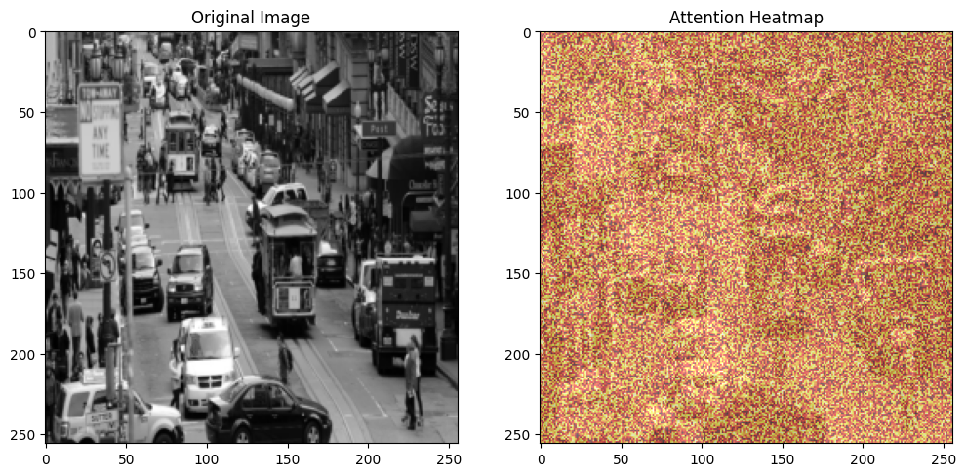
Techniques
Multi-Head Self-Attention:
Divides input embedding into multiple heads, focusing on various image regions simultaneously.
Enhances contextual awareness and accuracy in scene graph generation (SGG) tasks.
Graph Neural Networks (GNNs):
Uses GCNConv to process graph-based data, with nodes representing objects and edges representing relationships.
Improves relational reasoning capabilities by capturing connections and dependencies.
Figure 2: This figure illustrates the heatmap output of the attention .

Slide 7
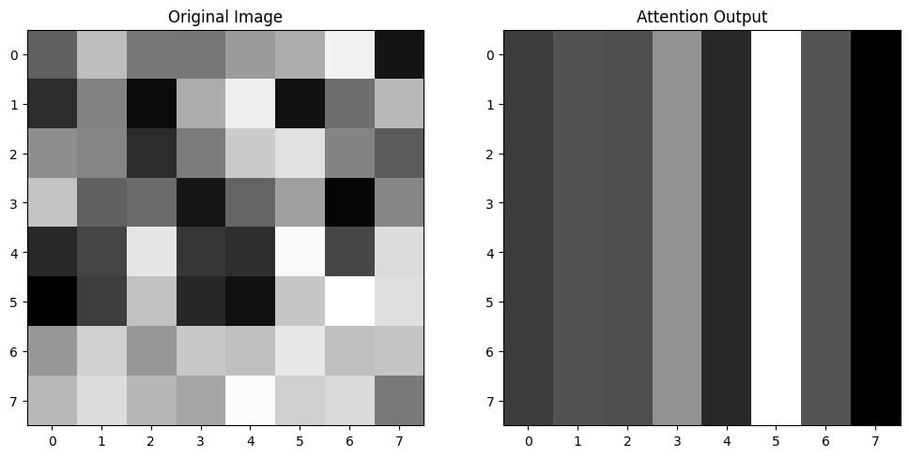
CNNs:
Extracts spatial features using convolutional and pooling layers, setting a foundation for further processing.
Provides essential data for SGG, capturing object-level information for subsequent analysis.
Faster R-CNN:
Pre-trained model for object detection, identifying and classifying objects with bounding boxes.
Forms a robust foundation for SGG, accurately detecting and classifying objects.
Knowledge Distillation
Trains a smaller student network to mimic a larger teacher network using a distillation loss function.
Encourages the student network to replicate the teacher's performance, combining cross-entropy and comparative loss functions.
Improves scalability and efficiency, reducing costs and making it feasible for real-world applications.
Figure 1: This figure shows an image before and after applying the multi head attention model.

Slide 8
Computational Challenges and Solutions
Model Checkpointing: Uses torch.save to intermittently save the model's state, reducing computational demand.
Mixed-Precision Training: Enabled through NVIDIA's Apex, reducing memory footprint and accelerating training.
GNN Stabilization: Skip connections (via nn.Sequential) and learning rate scheduling (optim.lr.scheduler) for effective learning.
Attention Mechanisms: Trade-off addressed with Ray Tune hyperparameter tuning, choosing six attention heads.
Knowledge Distillation: Grid search tuning identifies a temperature of 3 for softening logits, optimizing validation accuracy.

Slide 9
Discussions and Result
Multi-Head Self-Attention:
Increases recall metrics, offering a more discriminating analysis of scene elements.
Helps identify both obvious and contextually significant relationships.
Graph Neural Networks (GNNs):
Improves the model's ability to encode and predict complex relationships.
Enables a richer, more detailed scene graph generation, akin to human perception.
Knowledge Distillation:
Streamlines the model, making it more efficient without significant accuracy loss.
Crucial for deploying advanced models in real-world scenarios where resources are limited.

Slide 10
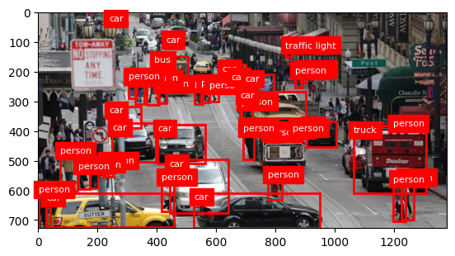
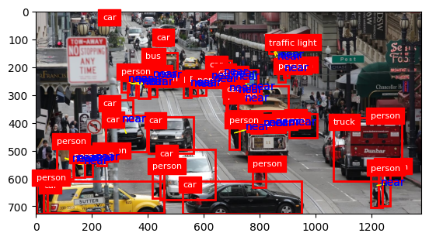
Fig 3:Model detects the objects and persons
Fig 4:Model detects Distance between Objects

Slide 11
Comparisons and Limitations
Advancements:
Our model improves scene graph generation quality and efficiency.
Metrics such as recall show improvement without compromising precision, addressing balancing challenges from the original work.
Comparison to Related Works:
Enhanced ability to understand complex scenes, particularly with high-density objects and intricate relationships, outperforming baseline methods.
Limitations:
Potential for overfitting due to increased model complexity, mitigated but not fully eliminated by regularization techniques.
Knowledge distillation reduces model size, potentially leading to loss of nuance in edge cases.

Slide 12
Conclusion
Enhanced Scene Graph Generation:
Our research successfully integrates multi-head self-attention mechanisms, GNNs, and knowledge distillation, significantly improving upon MOTIFNET's interpretative capabilities.
Rigorous experimentation validates these enhancements, showing a comprehensive capture of object relationships in complex scenes.
Implications for Computer Vision:
The enriched model paves the way for sophisticated image and video analysis tools, benefiting fields such as autonomous navigation, augmented reality, and interactive robotics.
Balanced Performance:
The approach balances enhanced performance with computational efficiency, making it suitable for real-world scenarios where resources are limited.

Slide 13
Future Work
Dynamic Scene Understanding:
Extend methodologies to video data, transitioning from static scene graph generation to dynamic understanding.
Diverse Datasets:
Evaluate performance across more diverse datasets to assess generalization capabilities.
New Neural Architectures:
Explore integrating different neural network architectures, such as Transformer models, for further improvements.
Knowledge Distillation Refinement:
Further refine techniques to enhance model efficiency without compromising the depth of interpretation.

Slide 14
Thank you

